Slide 1
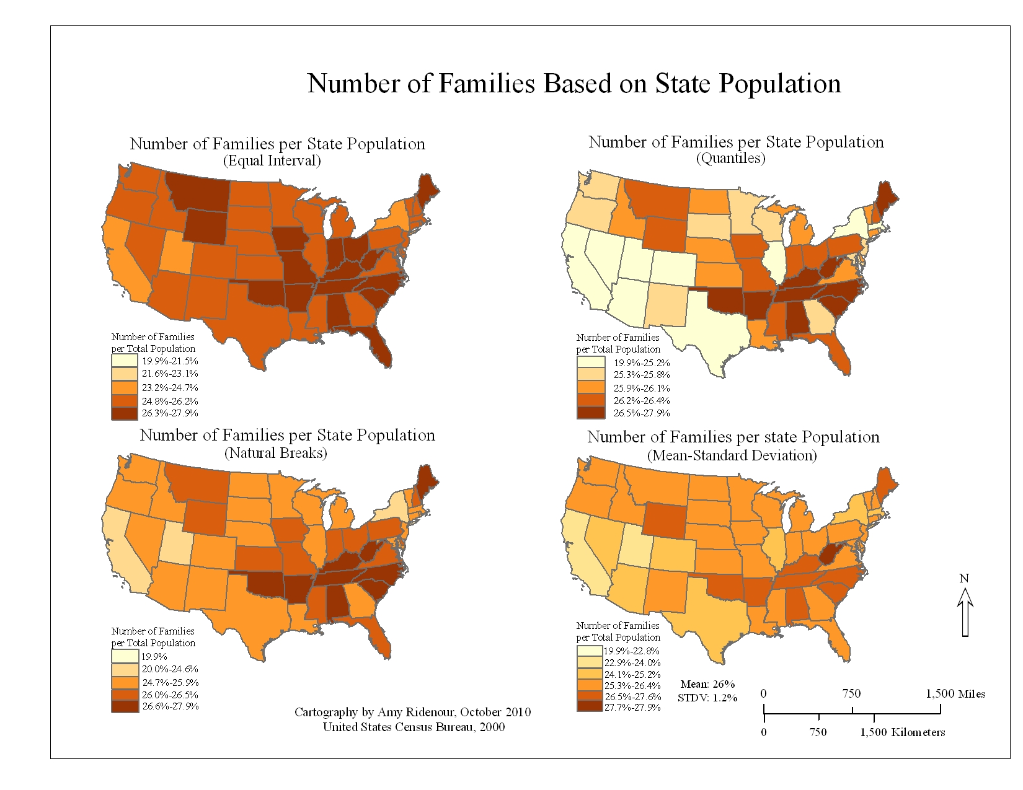
Week 3: Classification/Descriptive statistics
Geog4300: Shannon

Slide 2
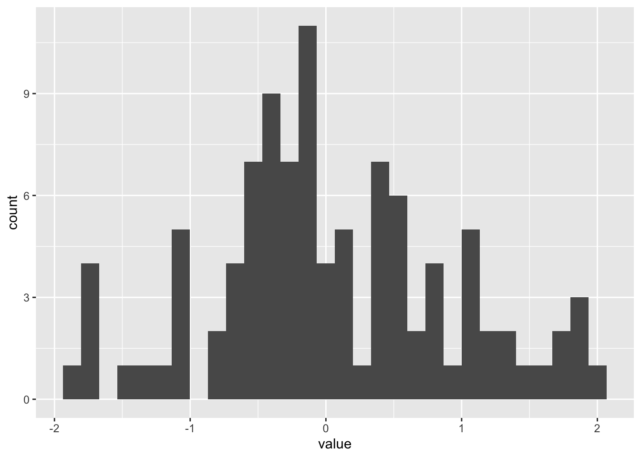
This week: Descriptive statistics
Measures of central tendency:
Mean
Median
Mode
Measures of distribution:
Standard deviation
Interquartile range (IQR)
Coefficient of variation

Slide 3
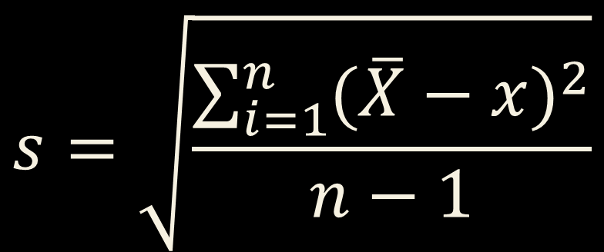
Measuring standard deviation
What’s the mean of all your rolls? (X bar)
What’s the difference between the mean and each of your individual rolls? (Squared and summed)
How many rolls do you have?
$$s=\sqrt{\frac{\sum_{i=1}^{n}{{(\overline{X}−x)}^{2}}}{n−1}}$$

Slide 4

Let’s roll!
Roll your dice 10 times.
BY HAND: What’s the mean (sum of all rolls/10), median (average of two middle values), and standard deviation?

Slide 5
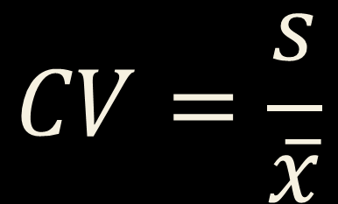
Coefficient of variation
Standard deviation divided by the mean
Useful when means vary across groups or measures
$$CV=\frac{s}{\overline{x}}$$

Slide 6


R challenge!
Load the Daymet data we will use in lab 1 and calculate the mean, standard deviation (sd), and cv for prcp by county. You’ll need to use group_by, summarise, and mutate.
Which counties have the highest cv? How does that compare to standard deviation?
$$CV=\frac{s}{\overline{x}}$$

Slide 7
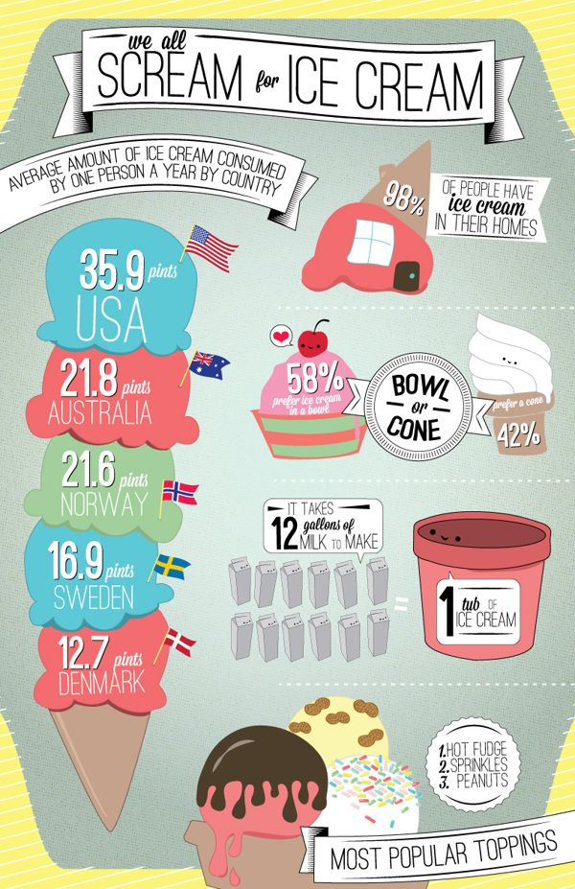
What’s your favorite flavor of ice cream?
How could we classify these flavors?

Slide 8
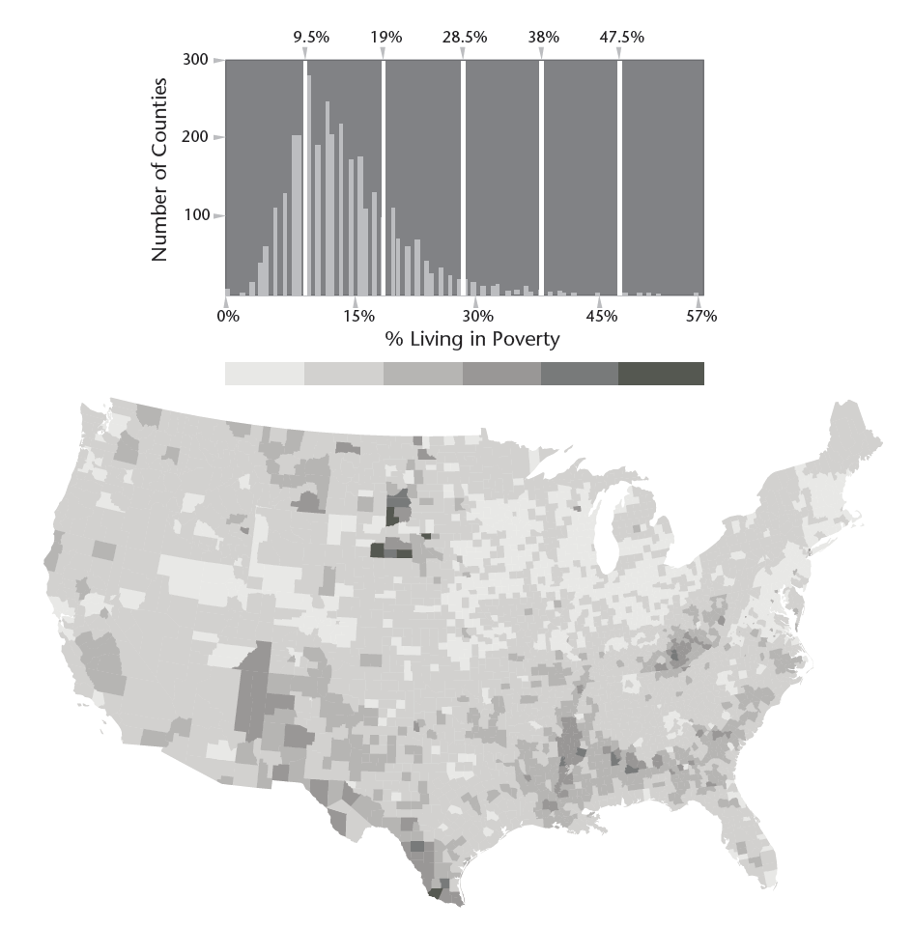
Numeric Classification schemes
Equal interval
Quantile
Natural Breaks
Notes:
Depending your approach, classification methods can paint very different pictures of the same data points.
How might we interpret the natural breaks map differently from the quantiles map here?

Slide 9
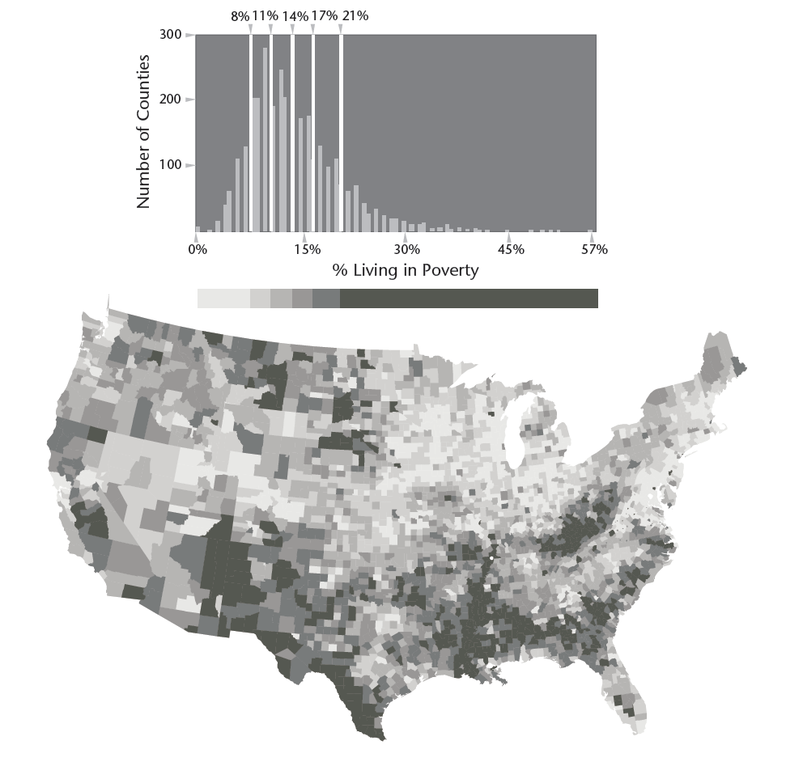
Numeric Classification schemes
Equal interval
Quantile
Natural Breaks
Notes:
Depending your approach, classification methods can paint very different pictures of the same data points.
How might we interpret the natural breaks map differently from the quantiles map here?

Slide 10
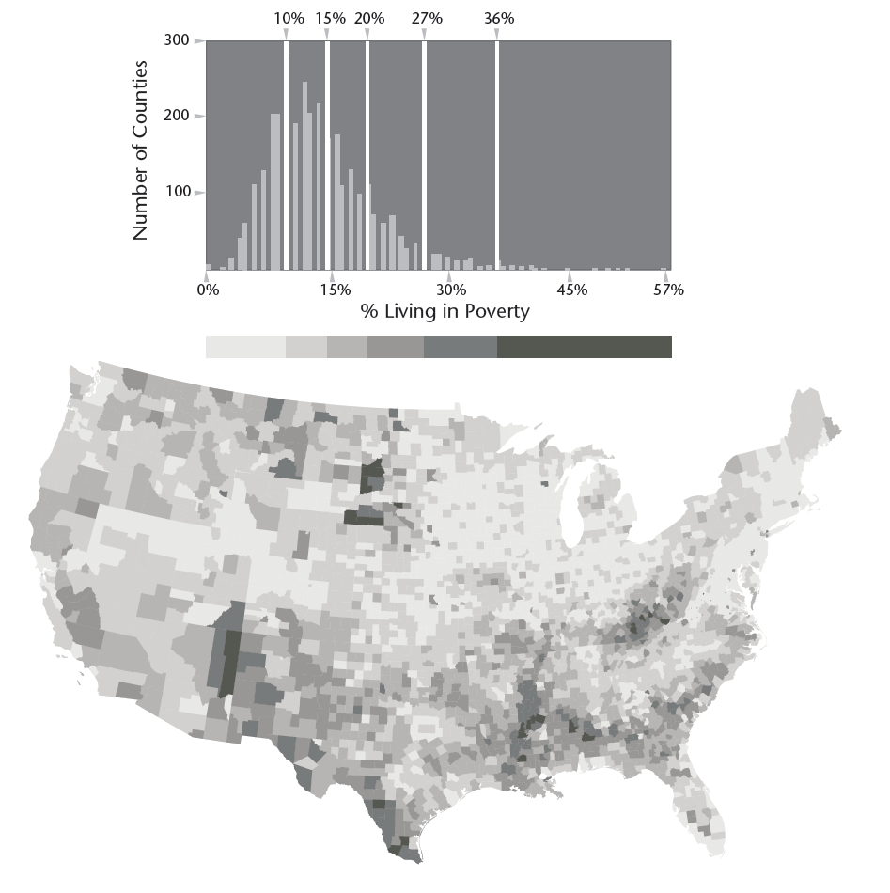
Numeric Classification schemes
Equal interval
Quantile
Natural Breaks
Notes:
Depending your approach, classification methods can paint very different pictures of the same data points.
How might we interpret the natural breaks map differently from the quantiles map here?

Slide 11
Numeric Classification schemes
Equal interval
Quantile
Natural Breaks
Choose based on your data and the analysis you’re doing
Notes:
Depending your approach, classification methods can paint very different pictures of the same data points.
How might we interpret the natural breaks map differently from the quantiles map here?

Slide 12
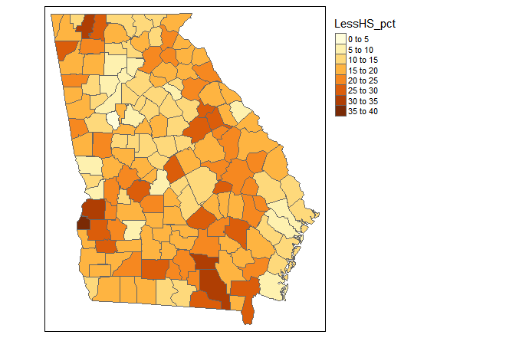
What’s a “low education county?”
Notes:
Depending your approach, classification methods can paint very different pictures of the same data points.
How might we interpret the natural breaks map differently from the quantiles map here?

Slide 13
How could we decide?
Based off the data/Relative measure
How many standard deviations below the mean?
What percentile of all counties?
Based off the research/Absolute measure
What’s the average of a larger area (e.g., national/international)?
What has been used by other researchers?
Notes:
Depending your approach, classification methods can paint very different pictures of the same data points.
How might we interpret the natural breaks map differently from the quantiles map here?

Slide 14
You try it!
Open the county census data CSV spreadsheet in Excel/Google Sheets
What are the mean, median and standard deviation for LessHS_pct and HS_Grad_pct nationally?
=AVERAGE, =MEDIAN,=STDEV
What values determines the 25th and 75th percentile for each of these values?
=QUARTILE(range,1) and =QUARTILE(range,3)
Which are the better measures of central tendency/ distribution?
Notes:
Depending your approach, classification methods can paint very different pictures of the same data points.
How might we interpret the natural breaks map differently from the quantiles map here?

Slide 15
You try it!
How many counties in Georgia fall below the 25th percentile for each of these variables?
How many are two or more standard deviations below the mean?
How would you classify a “low-education county” based on these data? What might that miss?
Notes:
Depending your approach, classification methods can paint very different pictures of the same data points.
How might we interpret the natural breaks map differently from the quantiles map here?

